Slide 1
Foundations of Individual Behavior

Slide 2
Learning
Learning can be defined as a relatively permanent change in behavior or potential behavior as a result of direct or indirect experience.
Learning is thus a change in behavior as a result of experience.

Slide 3
Types of Learners
(1) Visual learners: learn primarily through the written word.
2. Auditory Learners: Auditory learners learn primarily through listening.
3. Kinesthetic Learners: Kinesthetic learners learn better by doing.

Slide 4
Learning process
1. Readiness (interest)
2. Exercise (practice)
3. Effect (feelings)
4. Primacy (first)
5. Intensity (exciting)
6. Recency (latest)

Slide 5
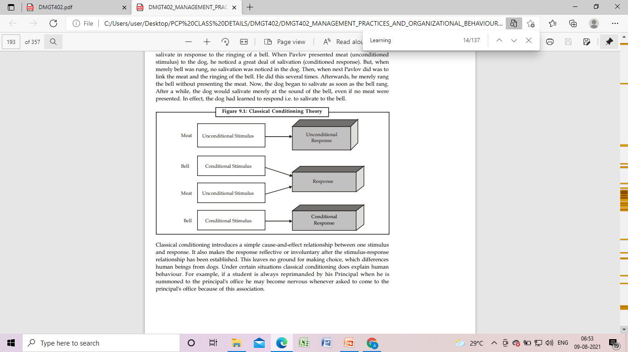
Classical Conditioning

Slide 6
Operant Conditioning
Operant conditioning argues that behavior is a function of its consequences. People learn to behave to get something they want or avoid something they don't want.
The tendency to repeat such behavior is influenced by the reinforcement or lack of reinforcement brought about by the consequences of the behavior.
Reinforcement therefore strengthens behavior and increases the likelihood it will be repeated.

Slide 7
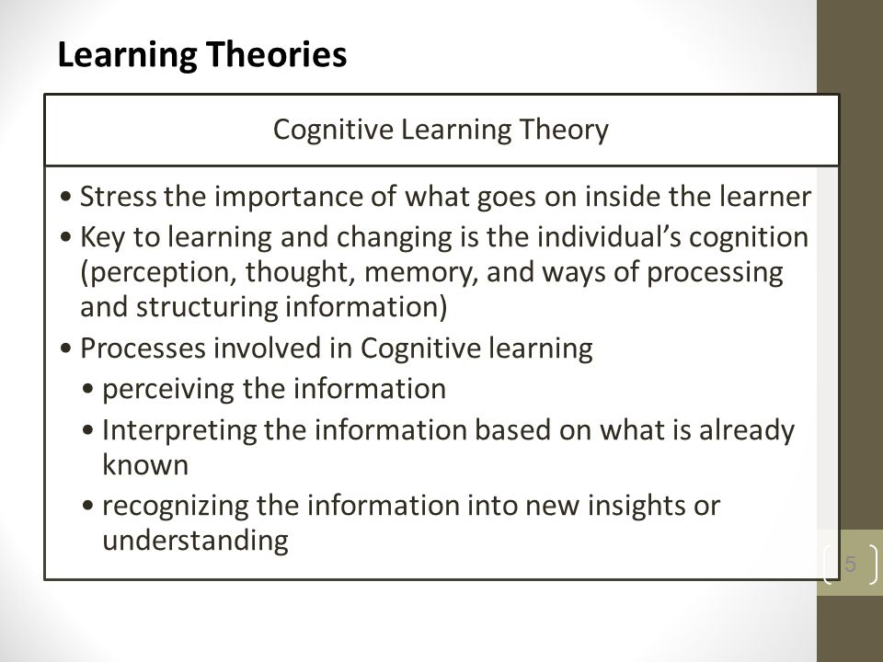
Cognitive Learning Theory

Slide 8
Social Learning
Social learning integrates the cognitive and operant approaches to learning.
It recognizes that learning does not take place only because of environmental stimuli or of individual determinism but is a blend of both views.
It also emphasizes that people acquire new behaviors by observing or imitating others in a social setting.

Slide 9
Attitude and Job Satisfaction

Slide 10
Attitudes
Attitude is defined as a more or less stable set of predisposition of opinion, interest or purpose involving expectancy of a certain kind of experience and readiness with an appropriate response.
Components of Attitudes
1. Cognitive component (belief)
2. Affective component (feelings)
3. Behavioral component. (reaction/behavior)

Slide 11
Job Satisfaction
Job satisfaction is defined as the extent to which an employee feels self-motivated, content & satisfied with his/her job.
Job satisfaction happens when an employee feels he or she is having job stability, career growth and a comfortable work life balance.

Slide 12
Personality
Personality refers to individual differences in characteristic patterns of thinking, feeling and behaving.

Slide 13
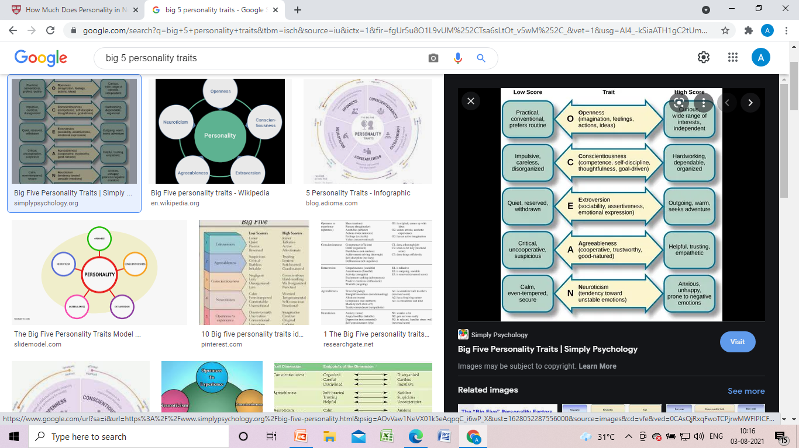
The Big 5 Personality Traits

Slide 14
Personality types
1. Extraverted or Introverted
2. Sensing or Intuitive
3. Thinking or Feeling
4. Judging or Perceiving

Slide 15
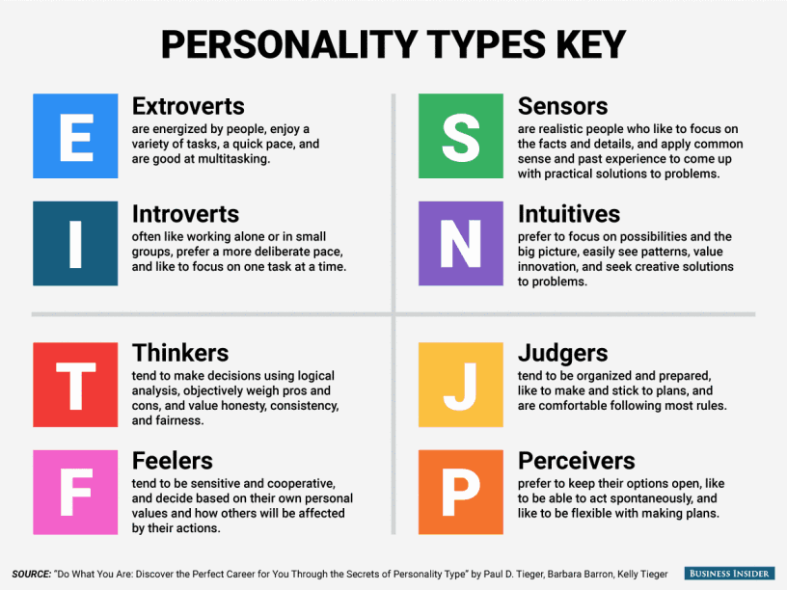

Slide 16
Emotions
An emotion is a mental and physiological state associated with a wide variety of feelings, thoughts, and behavior.

Slide 17
Emotional Intelligence
Emotional Intelligence is a term that describes the ability, capacity, skill to identify, assess, and manage the emotions of one's self, of others, and of groups.

Slide 18
Affective Events Theory
Affective Events Theory (AET) is a model developed by organizational psychologists Howard M. Weiss and Russell Cropanzano to identify how emotions and moods influence job performance and job satisfaction.
According to the AET, environmental exigencies generate "affective events" that cause emotional reactions in organizational members which, in turn, determine members' attitudes and behaviors.

Slide 19
Perception
Perception is the identification, organization and interpretation of sensory information in order to represent and understand the presented information or environment.
Perception is how we, as individuals, asses situations.

Slide 20
Factors that Influence Perception
1. Perceiver
2. Situation
3. Target

Slide 21
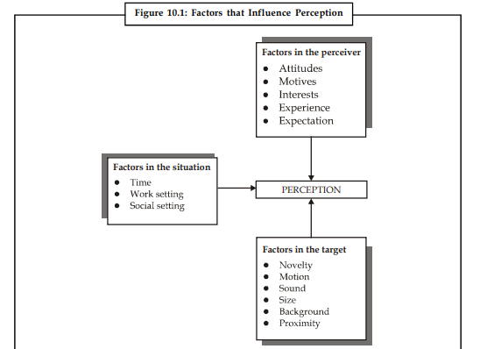

Slide 22
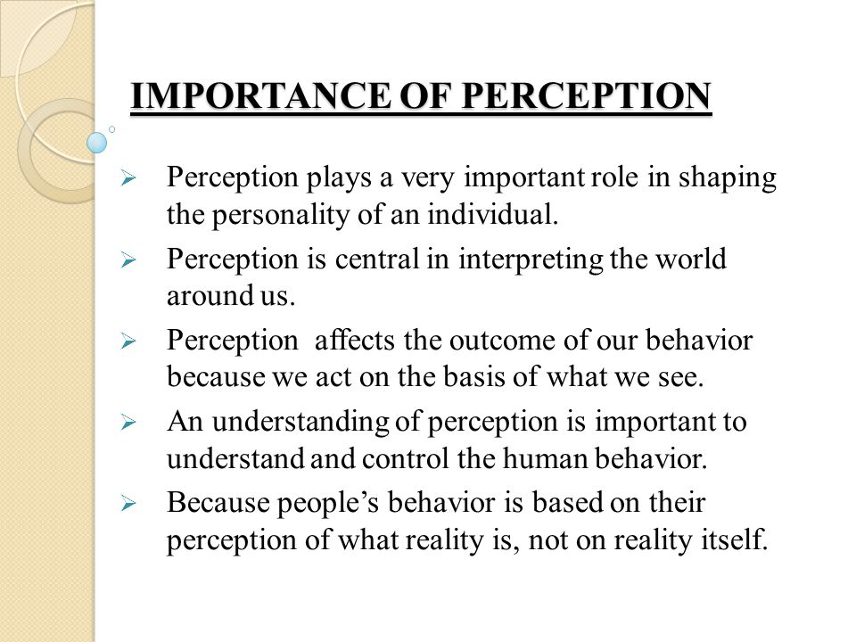
………..

Slide 23
Attribution theory
Attribution theory has been proposed by Harold Kelley to develop explanations of the ways in which we judge people differently, depending on what meaning we attribute to a given behavior.
Attribution is a perceptual process.
The way we explain success or failure – whether our own or that of another person – affects our feelings and our subsequent behavior.

Slide 24
